Slide 1

Before We Begin...
All links can be found on: https://uwb-acm.github.io/Git-Gud-Workshop/
Install Git (command line)
https://git-scm.com/downloads
Create a GitHub account if you don’t have one already.
Use a private email (not your school email)
https://github.com/
3. Open this URL for later:
https://github.com/UWB-ACM/Git-Gud-Workshop
Notes:
Should show this as people get into the room, write it on the whiteboard.

Slide 2
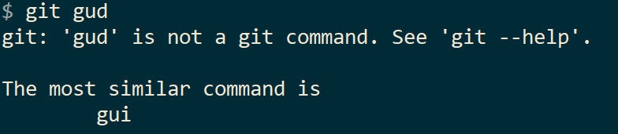
Git Gud
Workshop
By your friends at
UWB ACM
Notes:
· Provide the links and everything they need to set up beforehand (maybe let them know to keep it open on another window or tab). Make a landing page using github.pages to dump all the files they will need and have the url be memorable. · Explain Push/Pull Requests a bit in the beginning · Why git slide · Did they mention commit messages? · slide 23; add a screenshot of what it will look like · have a slide with everything you plan to go through and then show it again at the end to come full circle · Slide 26; maybe update graphics. Also, write out what you're explaining with the branches a bit · Slide 27; make sure the slide matches any written/drawn examples you give · Slide 29 before: fork · Mention -b flag · Slide 31; small drawing to explain pr flow (ref. second pic) · Slide 34; provide link for updating fork master from upstream or get rid of slide all together · Slide 37; maybe add labels, gitignore, releases and milestones to the list. These are all meant for them to google or look into on their own.

Slide 3
Agenda
Introduction and Definitions
Configuration
Workshop #1: First Commit
Workshop #1: Syncing with Remote
Workshop #3: Working with Files
Workshop #4: Contributing to Projects
Flow, GUIs, and Further Topic
Additional Resources

Slide 4
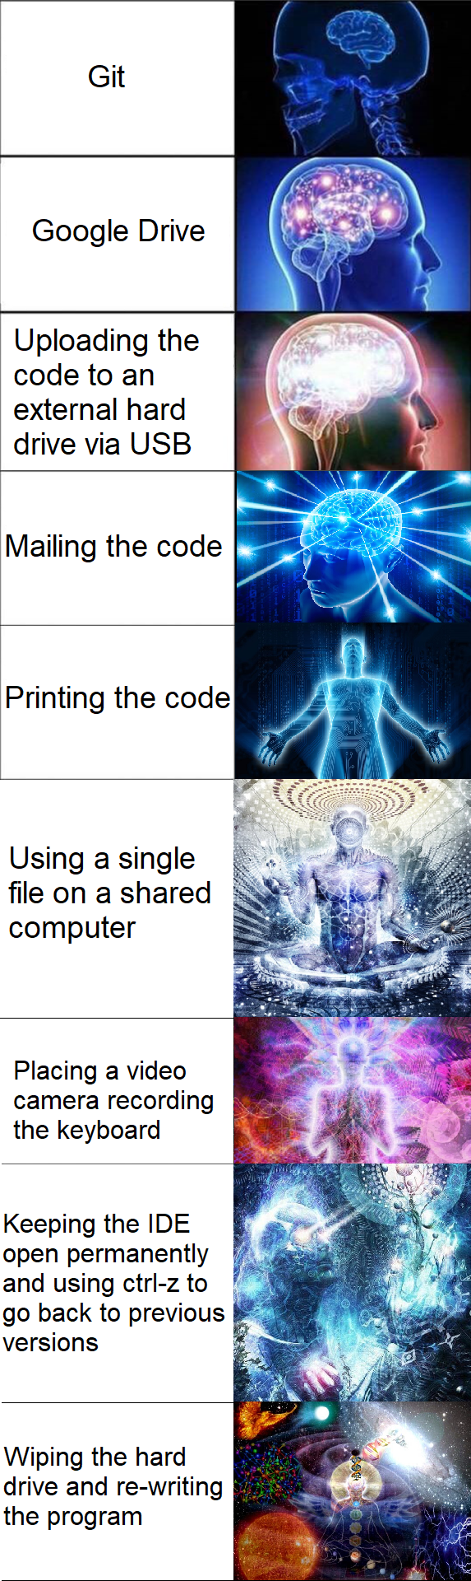

Slide 5
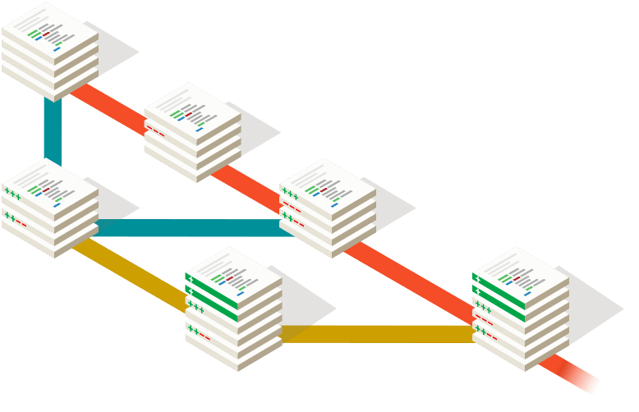
What’s Version Control?
(If you’ve had CSS 360, this may ring a bell)
Tracks revision history
Allows users to switch between versions
“Roll-back”
Teams can develop against “stable” version
Implemented in cloud drive platforms
e.g. Google Drive

Slide 6
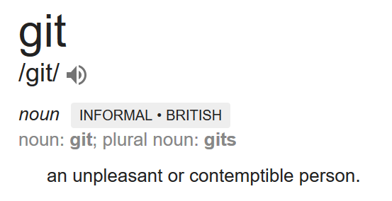
What’s Git?

Slide 7

Who? What?
What is Git?
Version Control Software!
Tool for tracking revisions of files
Enables synchronization for distributed teams
Who uses Git?
Amazon, Microsoft, Facebook, Netflix, Twitter, Linux, Android, Eclipse, Starbucks, Google, Hashicorp, eBay…
Over 31 million users on GitHub. (Git != GitHub)
Your classmates! (Solo, or for group projects)

Slide 8
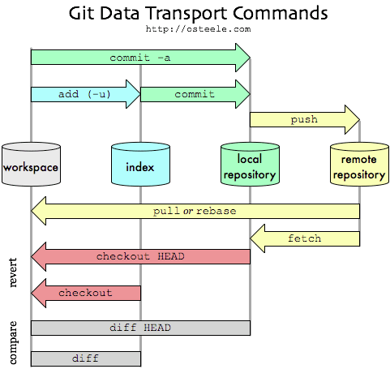
Why Git?
Keep files in sync!
Among workstations
Among teammates
Backup source code
Distributed collaboration
Work remote!
Manage complex workflows
It’s great for code!

Slide 9



What isn’t Git?
Git != GitHub
GitHub uses Git*
Git != Google Drive
(Git doesn’t sync in real-time)
≠
≠

Slide 10


Git != GitHub
Git (Launched April 2005)
Version Control Software
Independent of any online services
Doesn’t even have to connect online
GitHub (Launched April 2008)
Popular online service for hosting Git repositories, public or private
Add features that enhance an open-source software workflow
Issues
PRs
Support for Continuous Integration / CD

Slide 11
Version Control Vocabulary
Repo / Repository
A set of files, containing commits.
Commit
A set of changes applied to files, linked to the commit before it, with a message and author.
Diff
Changes between current state and last commit.
Branch
A set of commits that are linked to one another.
Remote
A server that hosts a Git repository.
Push
Sync local changes to a branch with a remote.
Pull
Retrieve changes from remote.

Slide 12
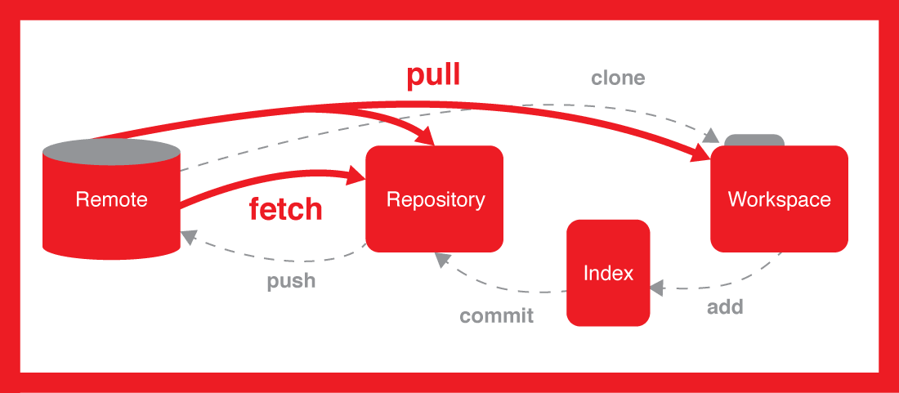
Ways to use Git
Locally: Repo only on your machine
Synced: Repo synced to remote
Remotes are often hosted*
Command Line Interface (Default)
Fully featured
Steeper learning curve
Graphical User Interface
May not be fully featured
Easy to use
IDE Plugins, GitHub Desktop, etc.
*Remote hosting
GitHub
GitLab
Bitbucket
SourceForge
Kiln
AWS CodeCommit
etc...

Slide 13
Git Commands Reference
Check out a cheat sheet here:
https://education.github.com/git-cheat-sheet-education.pdf
Shortlink:
https://bit.ly/1LHKj5a
Notes:
TODO Include this PDF in the repo

Slide 14
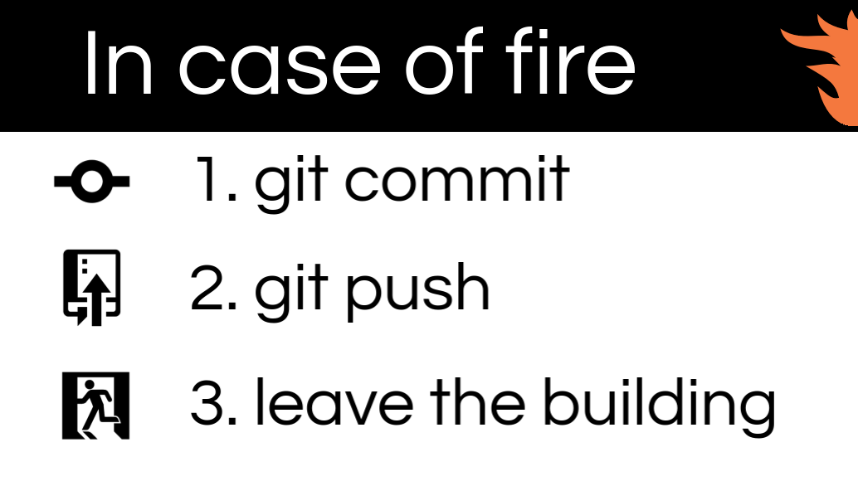
Git Commands Reference
git init : Makes the current directory into a Git repo.
git clone [url] : Downloads a repo from the given URL.
git add [files] : Adds the specified files to the staging area.
git rm [files] : Removes the specified files from the staging area.
git commit : Associates a message with the changes in the staging area, and add these changes to the repo’s history.
git checkout [reference] : Gets the contents of the repo from a specific commit.
git push : Uploads changes.
git pull : Downloads changes.

Slide 15

Git Config (First-Time Setup)
Git needs to know your username and e-mail to
associate your work with you.
Use the following commands:
git config --global user.name “Bobby Tables”
git config --global user.email bobby@tables.com
git config --global core.editor "nano"
Notes:
TODO double check that these are correct

Slide 16
Workshop #1: Our First Commit
Create a local repo
Create new files
Add files to our index
Commit changes to local repo
git init
echo “Hi!” >> hello.txt
(or equivalent)
git add hello.txt
git commit

Slide 17
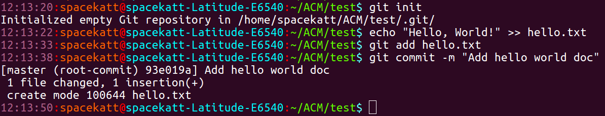
Workshop #1: Example
Initialize repo
Create text file
Add file to index
Commit file to repo
Notes:
TODO make some nicer screenshots

Slide 18
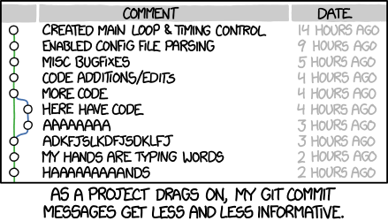
Writing Good Commit Messages
Qualities of a good commit message:
Use the imperative mood
“Add config file”
“Fix nginx SSL bug”
Subject is clear and descriptive, while under 50 characters in length.
Body adds detail and explanations
Avoid using git commit -m (do as I say, not as I do)
Further reading:
https://help.github.com/articles/closing-issues-using-keywords/
https://code.likeagirl.io/useful-tips-for-writing-better-git-commit-messages-808770609503

Slide 19
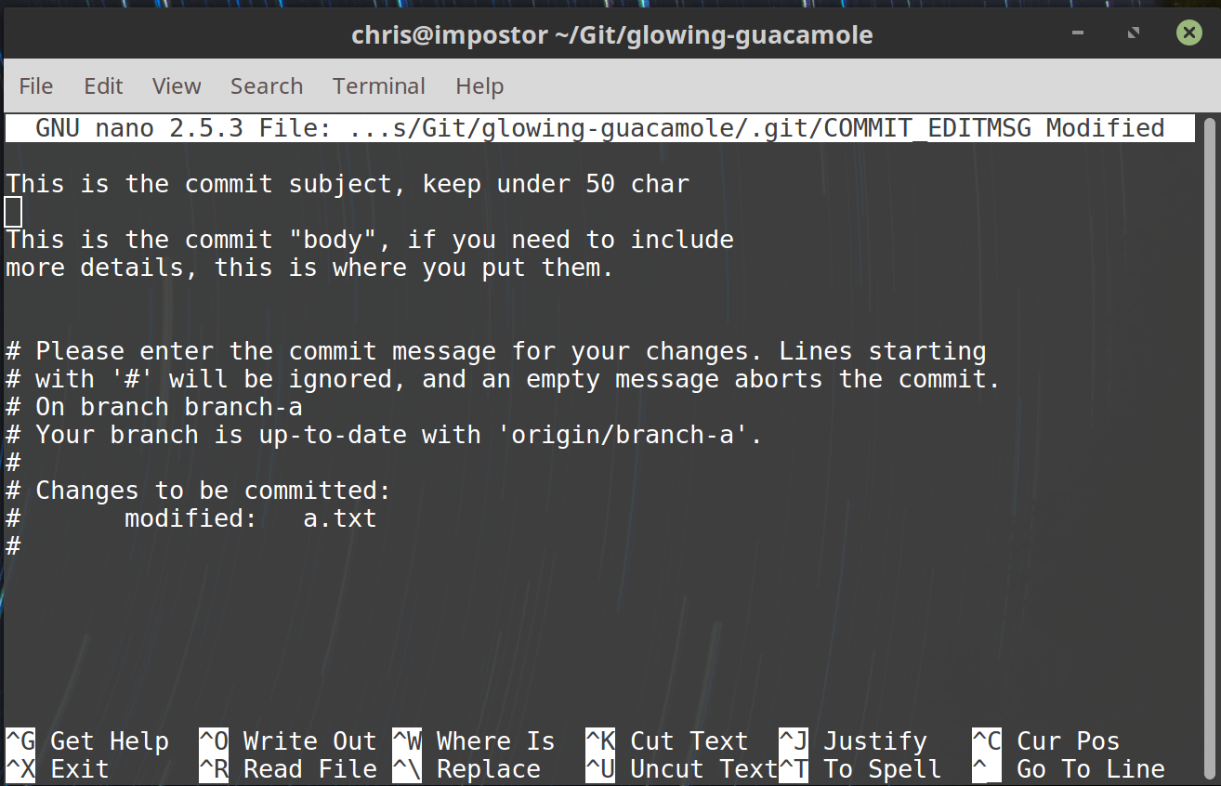
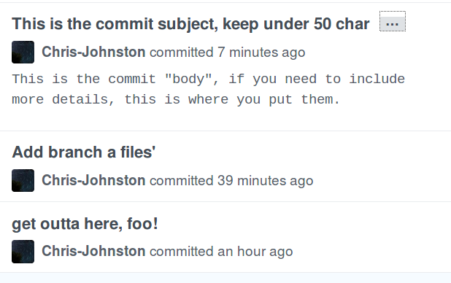
Commit Message Example
How others will see your message in GitHub

Slide 20
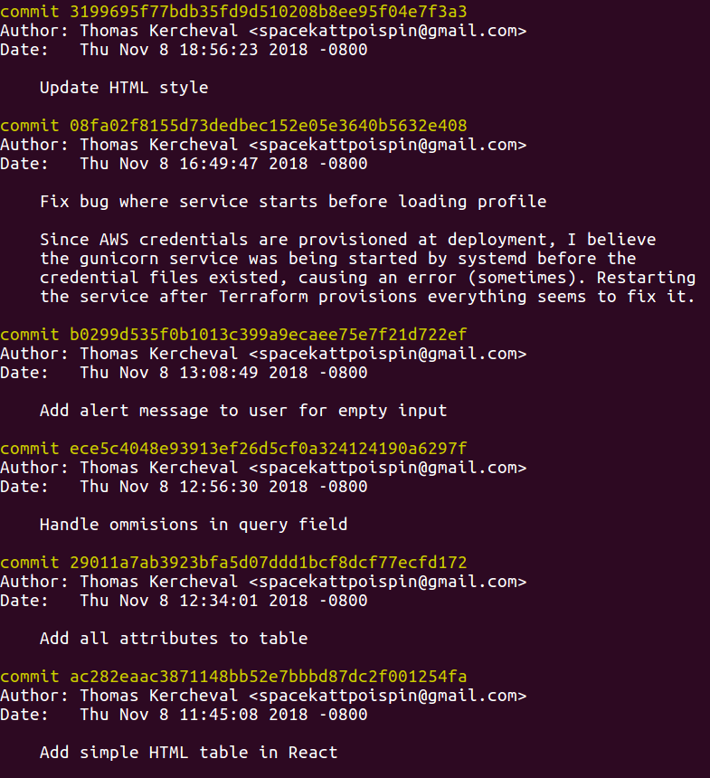
Viewing the log
View previous commit messages with...
git log
Benefits of a well-kempt log...
Workflow transparency
Process traceability
Bug tracking
Smaller commits
Easier merging

Slide 21
Workshop #2: Syncing to remote (GitHub)
Using the repository from Workshop #1...
Create remote repo (on GitHub)
Add reference to remote (URL) locally
Sync local changes to remote
<Create repo on GitHub>
git remote add origin <remote url>
git push -u origin master

Slide 22
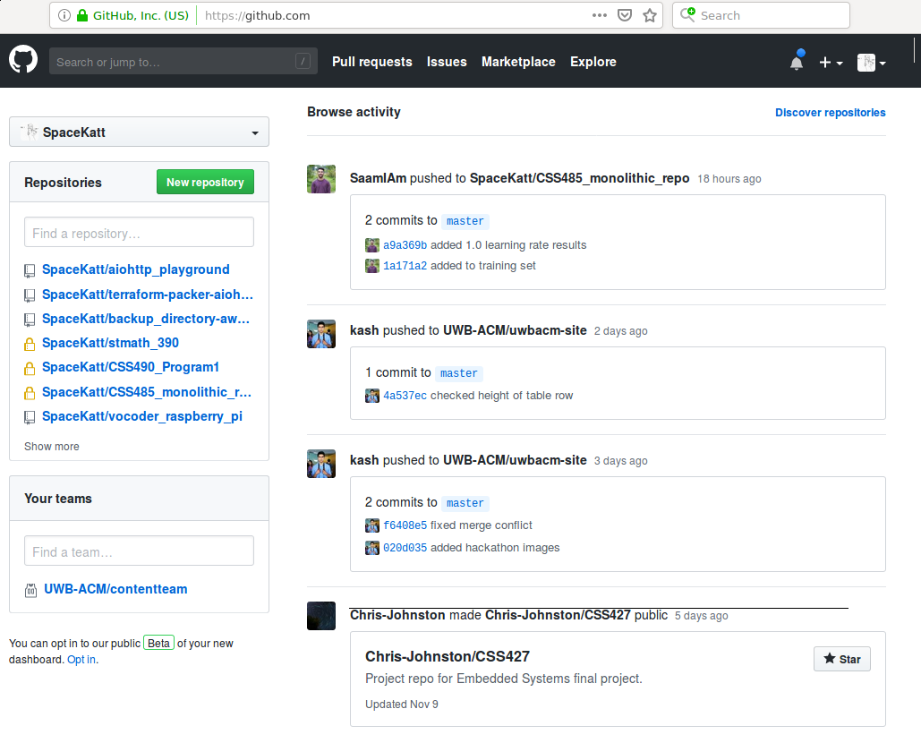
Create New
Repository
Click da’ button!

Slide 23
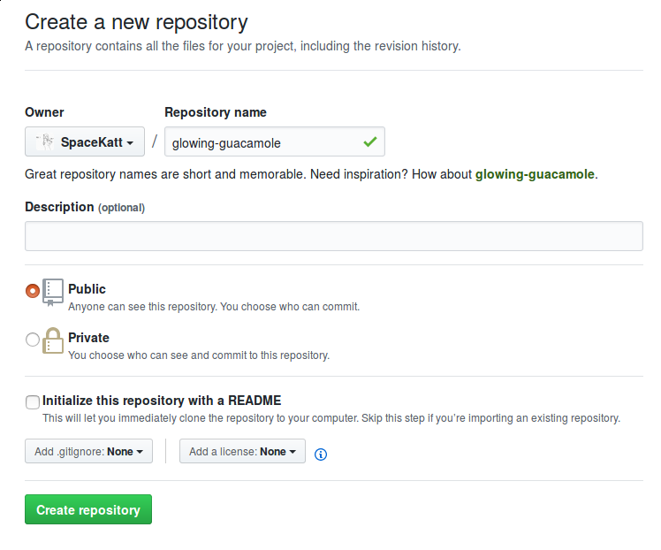
Name New
Repository
Give your new repository
some name…
If you’re hosting a cool project,
then use a descriptive name!
Don’t include a README, .gitignore, or license yet.

Slide 24
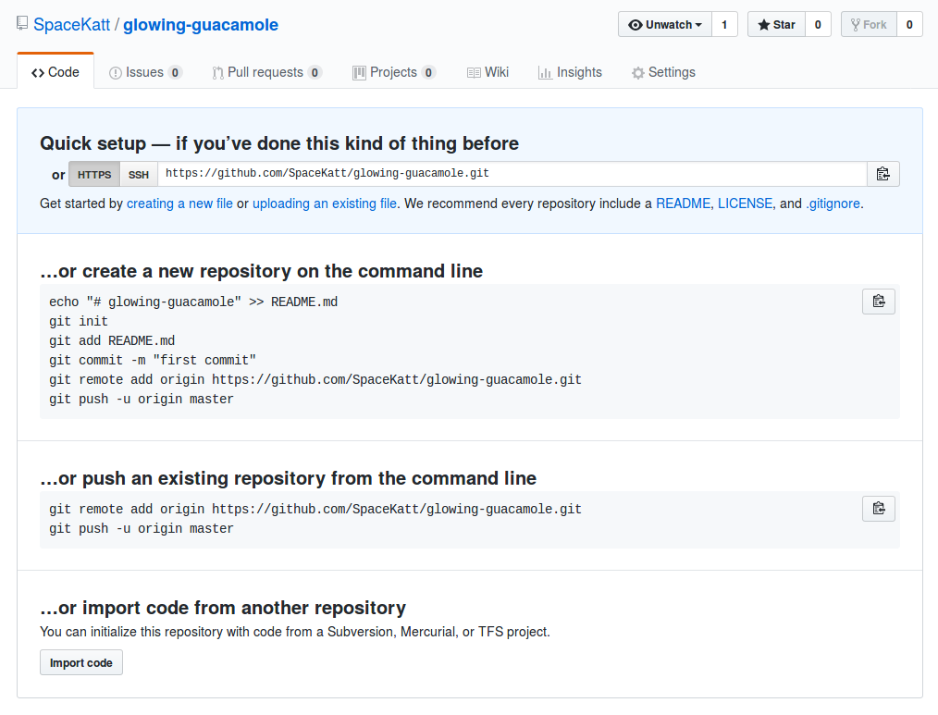
Copy URL
of repo
Click da’ button to copy
to your clipboard
Keep this page open
We will refresh it after
the next step!

Slide 25
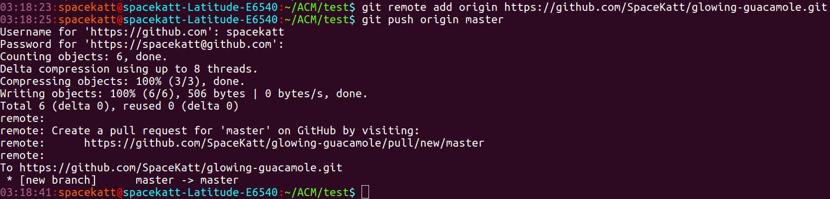
Add remote and push!
Add reference to the remote repository
Sync remote with local repo with push

Slide 26
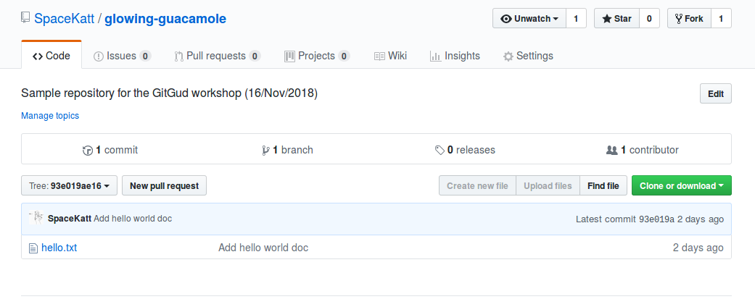
Refresh Repo Page on GitHub
We now see the file we pushed to our remote, origin
Exciting!
Much open source!
wow
Heckin’ origin

Slide 27
Workshop #3: Working with files
We are going to create a new file, commit it, and upload it to GitHub.
Then, once it’s uploaded, we are going to delete that file.
We can also use git mv in pace of git rm, if we desire to move a file, instead of removing it
echo “bar” >> foo.txt
git add foo.txt
git commit
git push
git rm foo.txt
git commit
git push

Slide 28
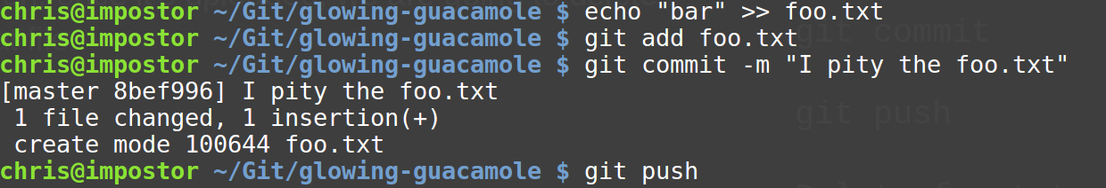
Workshop #3 Example: Sync File to Remote (i)
Create a new file
Add file to index
Commit it
Sync file to remote
echo “bar” >> foo.txt
git add foo.txt
git commit
git push

Slide 29
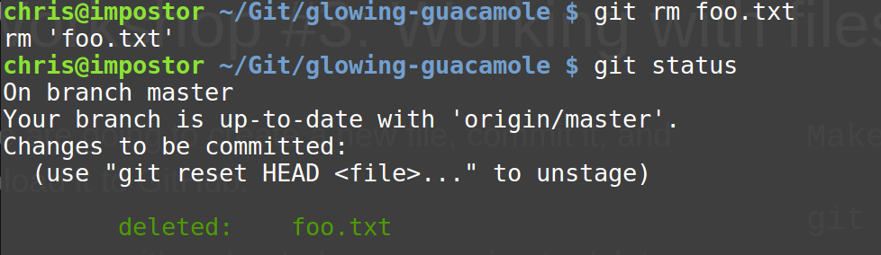
Workshop #3 Example: Tell git to Remove File (ii)
Tell git to remove file
Check file’s status
git rm foo.txt
git status

Slide 30
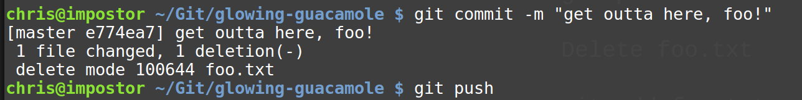
Workshop #3 Example: Sync Change to Remote (iii)
All we have to do now is synchronize!
Commit it
Push it to GitHub.
git commit
git push

Slide 31
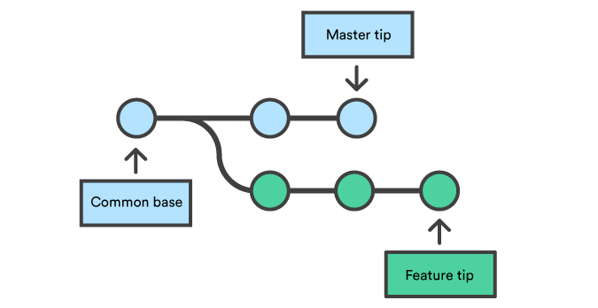
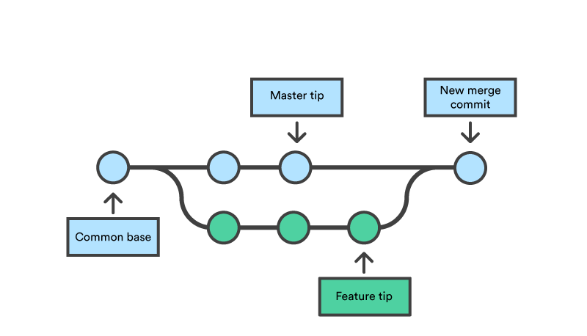
Branches?
Branches keep track of changes, from a shared starting point.
Branches can: - Separate from another branch - Merge into another branch - Contain different contents from another branch

Slide 32
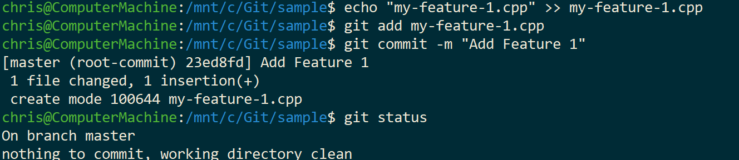
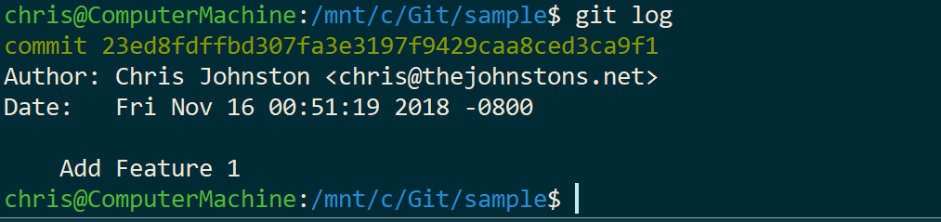
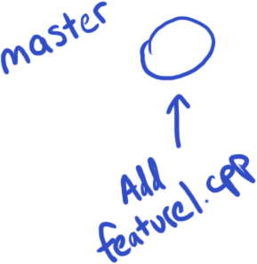
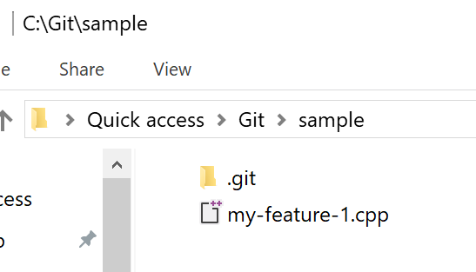
Branches (1 of 8)
Let’s use a new repo as an example.
In the master branch, we can add a new file for “Feature 1”.

Slide 33
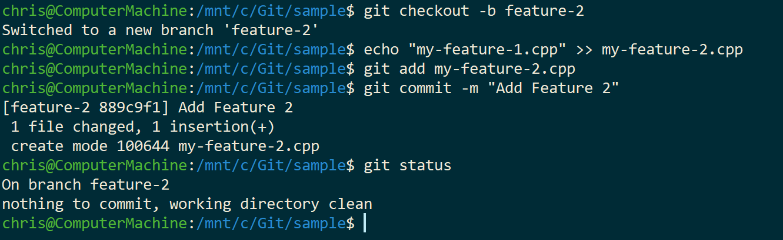
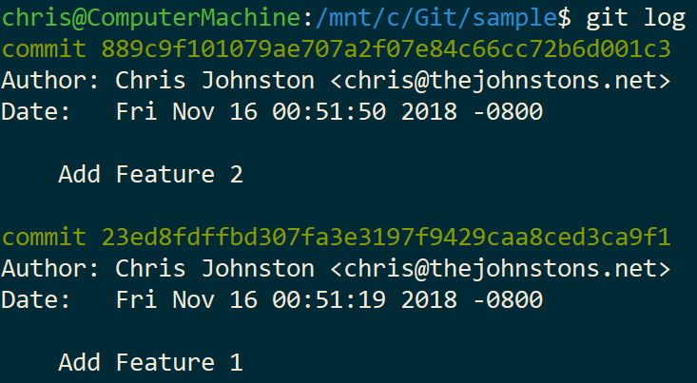
Branches (2 of 8)
Let’s branch off into a new branch, called “feature-2”.
In this branch, we’ll add a new file.

Slide 34
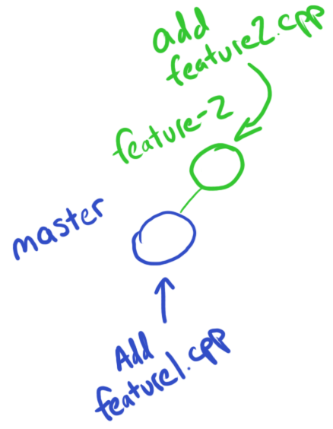
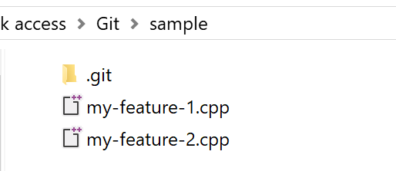
Branches (3 of 8)

Slide 35
Branches (4 of 8)
Uh-oh! Your boss just stopped by and wants to see your progress, but “Feature 2” is breaking the build! What do you do?
How do you show your boss the work you’ve done, but without discarding the hard work you’ve done on “Feature 2”?

Slide 36
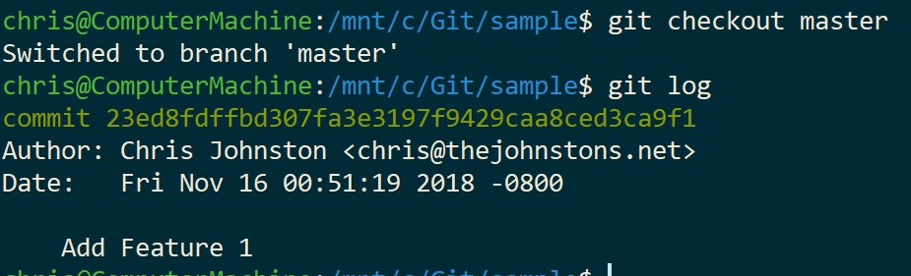
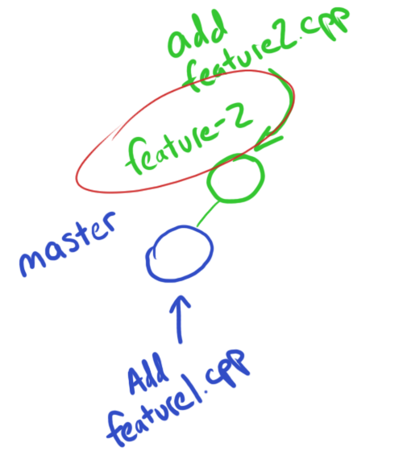
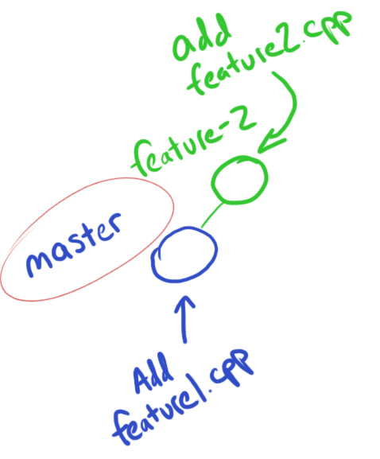
Branches (5 of 8)
Good for us, we’re using git!
We can use the git checkout command to switch back and forth without losing any progress.

Slide 37
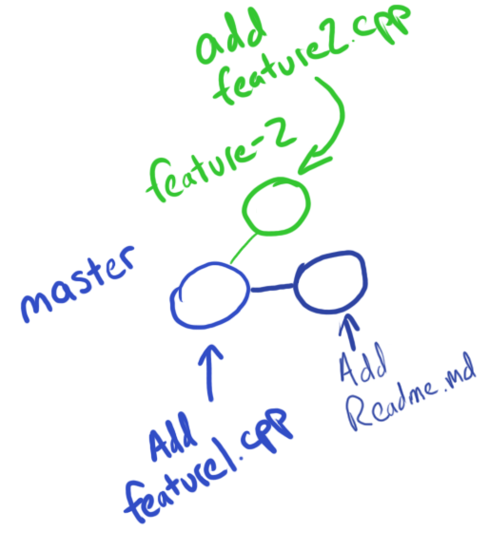
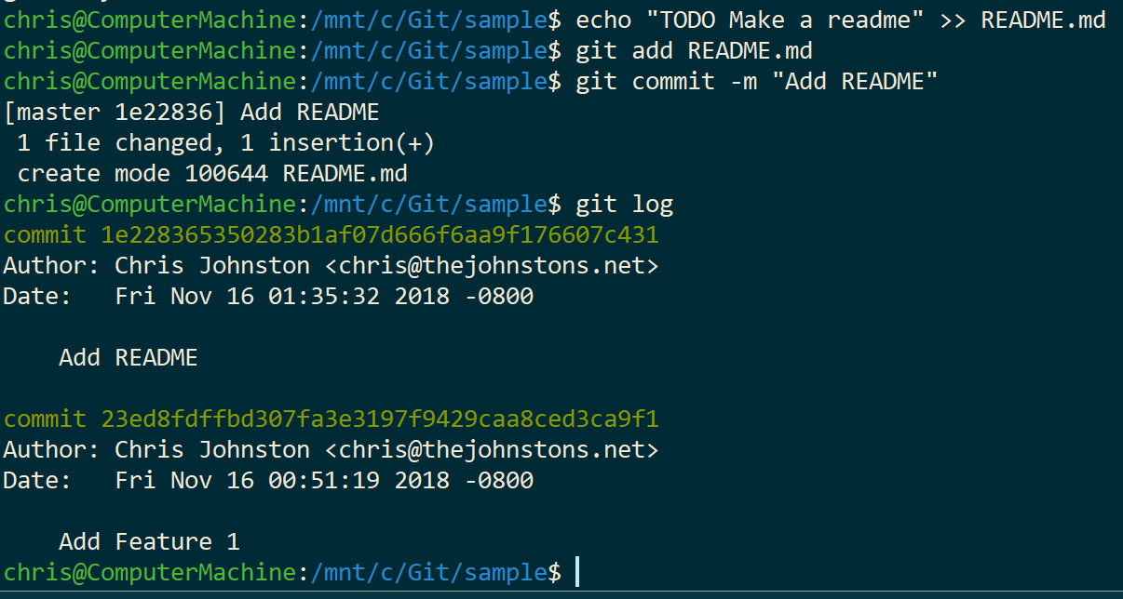
Branches (6 of 8)
Your boss asked you to create a Readme file to describe your project, so you added it to the master branch.

Slide 38
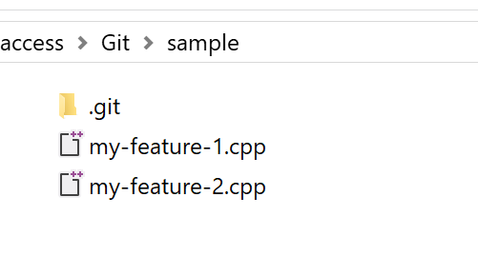
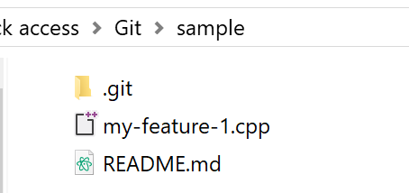
Branches (7 of 8)
Master
Feature-2
Same folder, different contents!

Slide 39
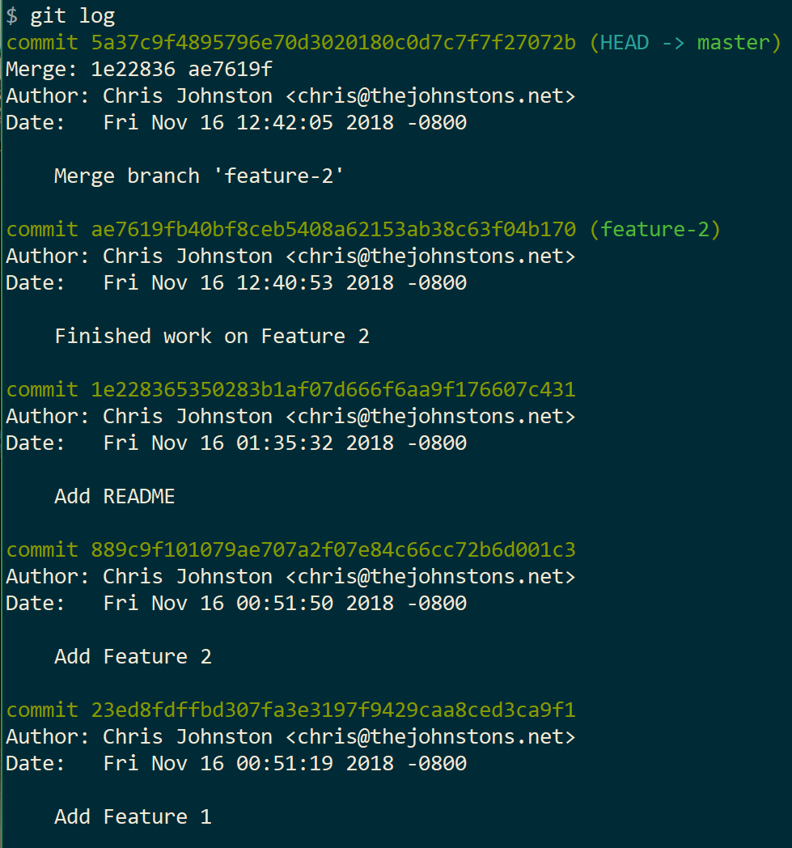
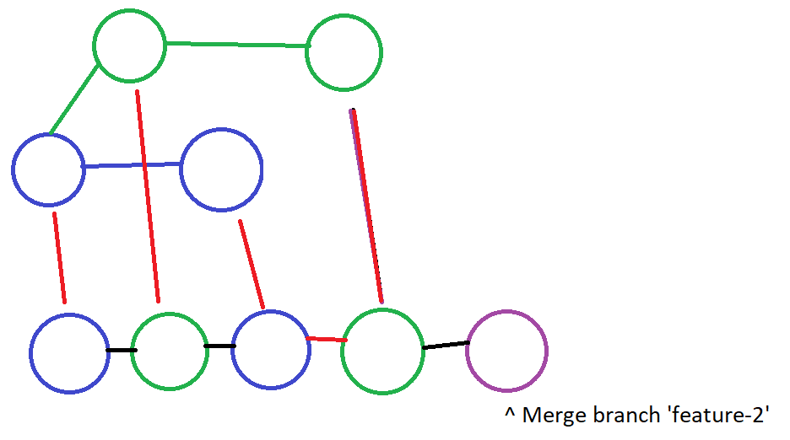
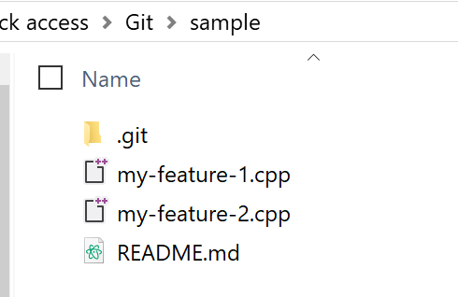
Branches (8 of 8)
So you’ve finished your work on Feature 2, and you want to add this back into the master branch. How do you do this? With merging!
git checkout master
git merge feature-2

Slide 40
Workshop #4: Contributing
https://github.com/UWB-ACM/Git-Gud-Workshop
Using git, we can contribute to a pre-existing codebase.
Fork the sample repo first
We will clone our sample repo, make a new branch, add some commits, upload them to our forked copy, and make a new pull request.
Create a file called:
jokes/<FirstName><LastInitial>.txt
Include a funny joke inside it, commit, and push it
Then, we open a pull request on GitHub, to signal upstream that we wish them to merge our work in.
[Fork repo on GitHub]
git clone <remote_forked_url>
cd folder
git checkout -b <branch_name>
echo “<joke>” >> jokes/BobbyT.txt
git add jokes/BobbyT.txt
git commit -m “<comment>”
git push origin <branch_name>
Open pull request [on GitHub]
Notes:
Alt-title: Making a PR
TODO add screenshots of where we walk through it
Forking the sample repo
Cloning your fork
Checking out a new branchyboi
Adding some change
Committing a change
Pushing change to your new branch
Opening a PR to see the change

Slide 41
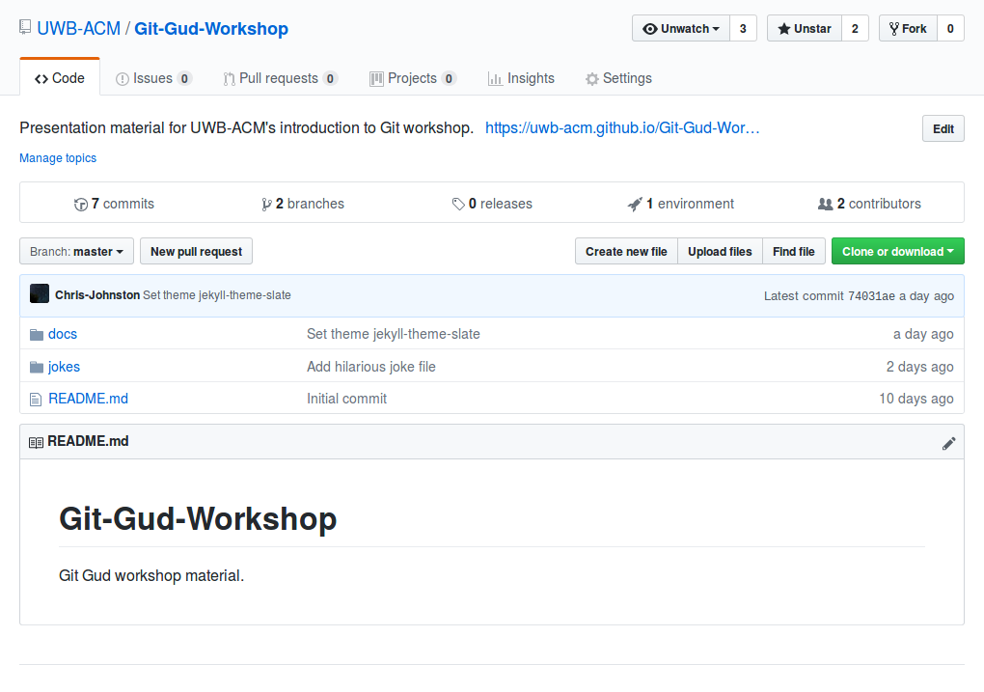
(1 of 6) Forking the repo
Use the Fork button!
This will give us a copy
Use the forked copy to modify project without interrupting upstream development
Notes:
Alt-title: Making a PR
TODO add screenshots of where we walk through it
Forking the sample repo
Cloning your fork
Checking out a new branchyboi
Adding some change
Committing a change
Pushing change to your new branch
Opening a PR to see the change

Slide 42
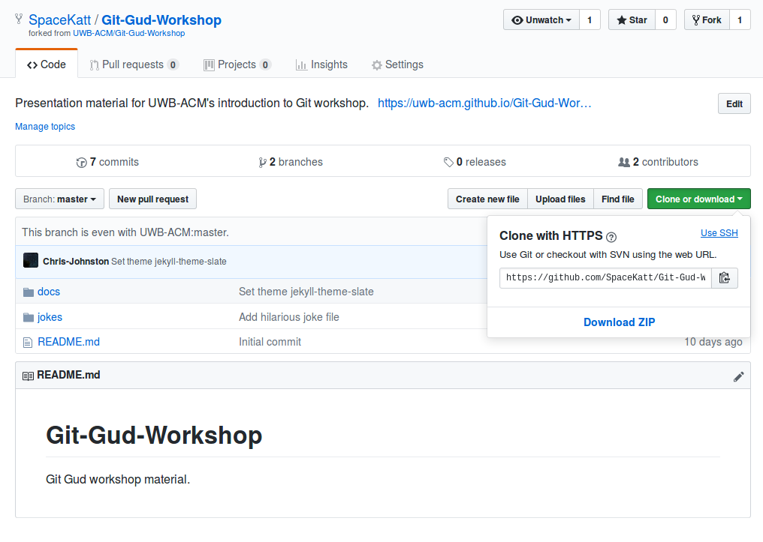
(2 of 6) Cloning the repo (part 1)
To clone your forked copy...
Copy remote’s URL
View URL
Copy to clipboard
We use this URL on next slide
Notes:
Alt-title: Making a PR
TODO add screenshots of where we walk through it
Forking the sample repo
Cloning your fork
Checking out a new branchyboi
Adding some change
Committing a change
Pushing change to your new branch
Opening a PR to see the change

Slide 43
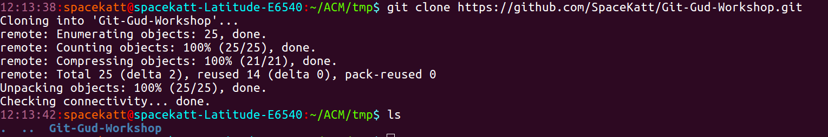
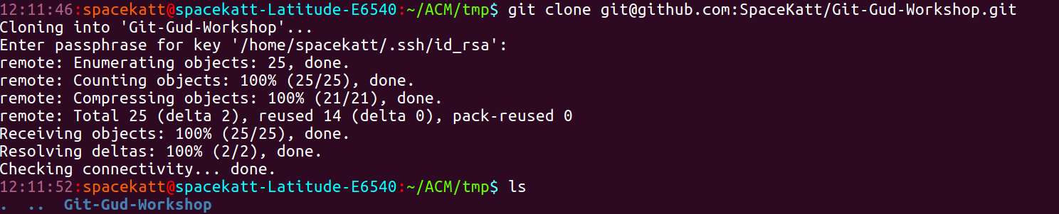
(3 of 6) Cloning the repo (part 2)
Cloning using HTTPS (Use this!)
[Don’t use this for the workshop] Cloning using SSH (requires setting up SSH keys)
Notes:
Alt-title: Making a PR
TODO add screenshots of where we walk through it
Forking the sample repo
Cloning your fork
Checking out a new branchyboi
Adding some change
Committing a change
Pushing change to your new branch
Opening a PR to see the change

Slide 44
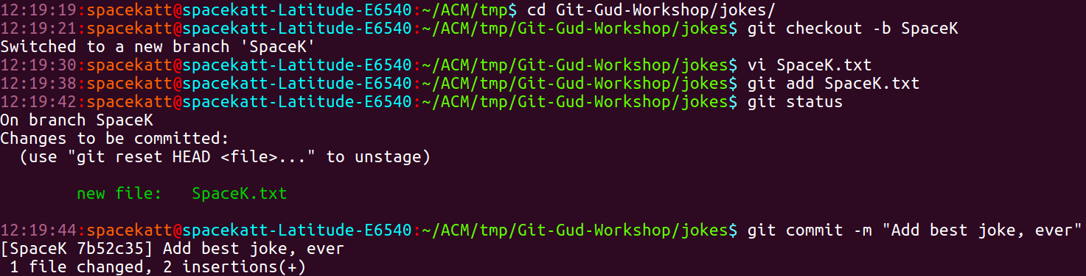
(4 of 6) Making a Joke
Create a new branch, with your first name and last initial
Create a file inside the jokes directory, with your first name and last initial
jokes/<FirstName><LastInitial>.txt
Inside it, include a funny joke. If it is not funny, you will be asked to leave.
Commit it
Notes:
Alt-title: Making a PR
TODO add screenshots of where we walk through it
Forking the sample repo
Cloning your fork
Checking out a new branchyboi
Adding some change
Committing a change
Pushing change to your new branch
Opening a PR to see the change

Slide 45
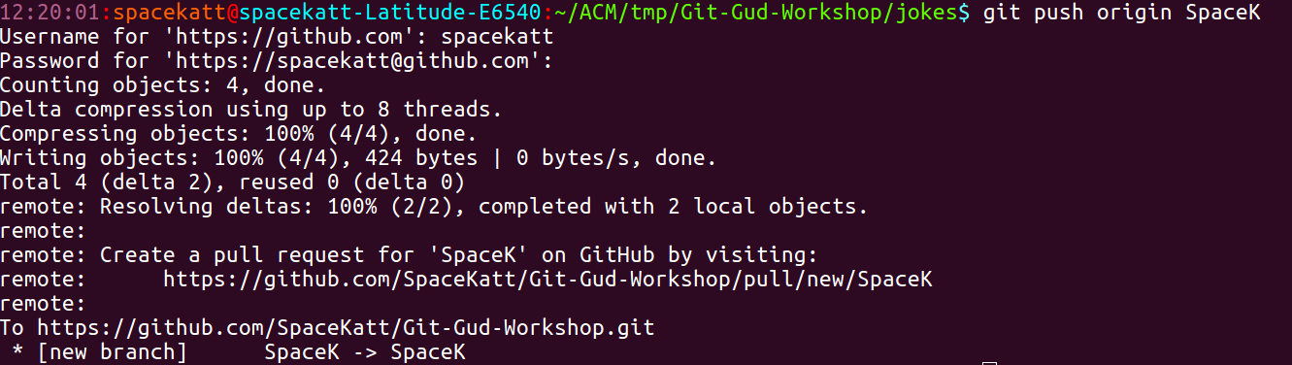
(5 of 6) Pushing your joke
Push your branch to remote
Remote is by default “origin”, from when we cloned the repo
For the next step (making a pull request) visit the URL shown below
Notes:
Alt-title: Making a PR
TODO add screenshots of where we walk through it
Forking the sample repo
Cloning your fork
Checking out a new branchyboi
Adding some change
Committing a change
Pushing change to your new branch
Opening a PR to see the change

Slide 46
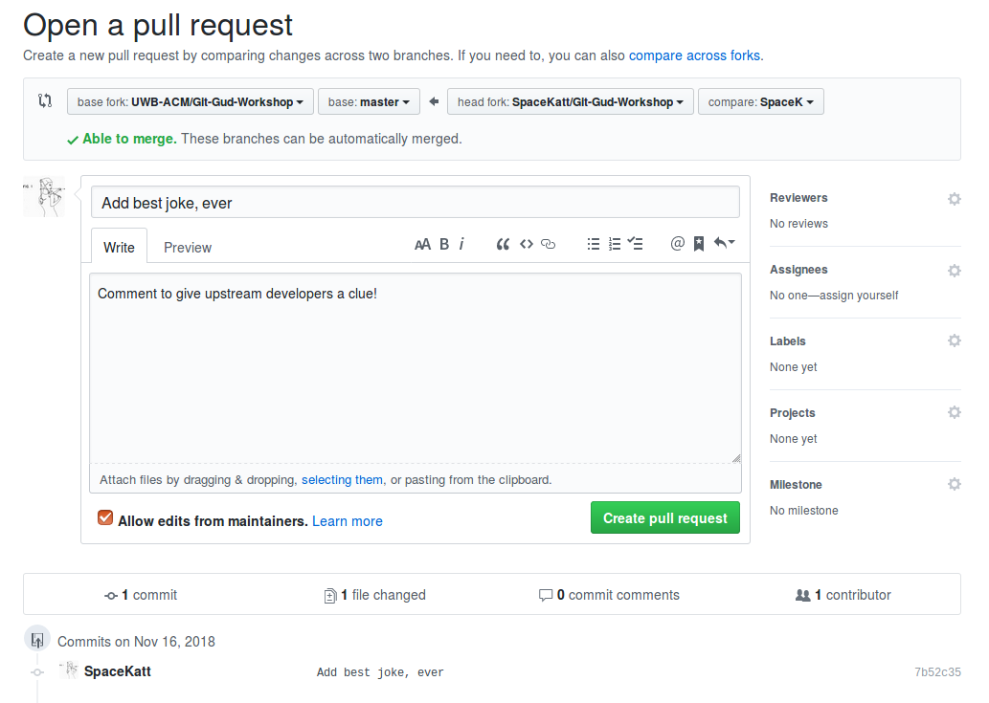
(6 of 6) Creating a pull request
Ensure “base fork” is set to master from “upstream”
Upstream is remote you forked repo from
Leave a comment
Click “Create pull request”
Now others can comment on your changes and approve them for integration into the code base.
Notes:
Alt-title: Making a PR
TODO add screenshots of where we walk through it
Forking the sample repo
Cloning your fork
Checking out a new branchyboi
Adding some change
Committing a change
Pushing change to your new branch
Opening a PR to see the change

Slide 47
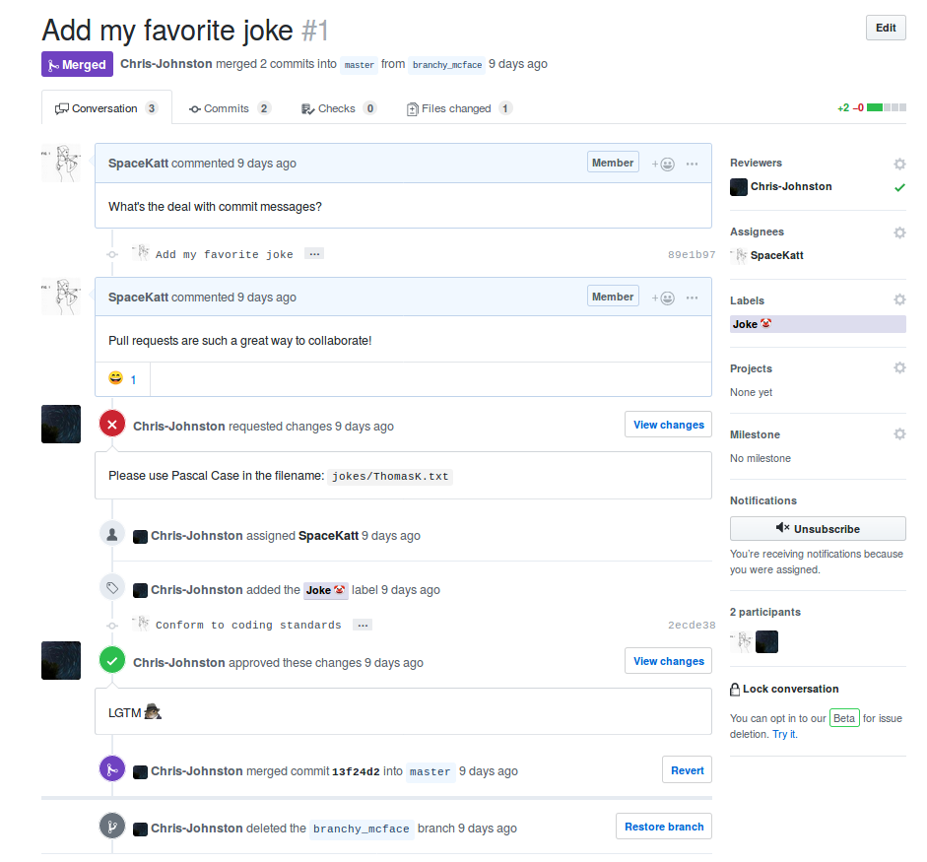
Collaborate!!!
Pull requests are a great way to
collaborate with your teammates
Code reviews
Code state management
Greater visibility of changes
Notes:
Alt-title: Making a PR
TODO add screenshots of where we walk through it
Forking the sample repo
Cloning your fork
Checking out a new branchyboi
Adding some change
Committing a change
Pushing change to your new branch
Opening a PR to see the change

Slide 48
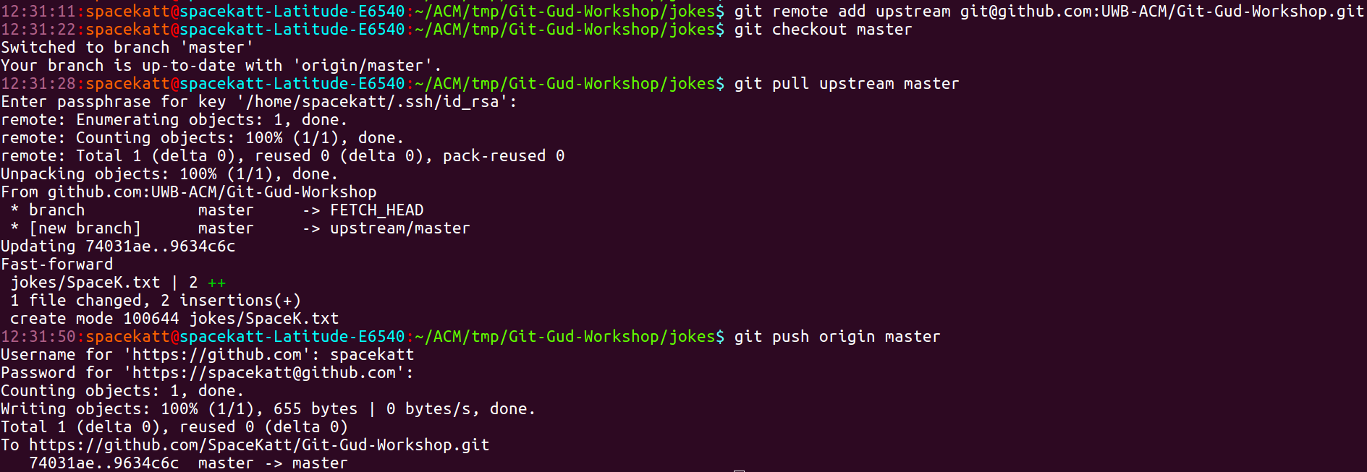
After your changes get merged...
To sync back with master after someone mergers your PR…
git remote add upstream <upstream_url> (Add remote reference to fork’s upstream)
git checkout master (Switch back to master branch)
git pull upstream master (Pull changes from remote [GitHub])
See our new file!?!?
Notes:
Alt-title: Making a PR
TODO add screenshots of where we walk through it
Forking the sample repo
Cloning your fork
Checking out a new branchyboi
Adding some change
Committing a change
Pushing change to your new branch
Opening a PR to see the change

Slide 49
Part II: After your changes get merged...
Update our remote fork after we fetch upstream changes
git push origin master (Synchronize our forked remote with changes from upstream)
Notes:
Alt-title: Making a PR
TODO add screenshots of where we walk through it
Forking the sample repo
Cloning your fork
Checking out a new branchyboi
Adding some change
Committing a change
Pushing change to your new branch
Opening a PR to see the change

Slide 50

Git Flow
“Git flow” is a pattern for how you can collaborate with others on the same codebase. We just did this!
GitHub explains this better than we can: (open this link)
https://guides.github.com/introduction/flow/
https://goo.gl/jgeusu

Slide 51
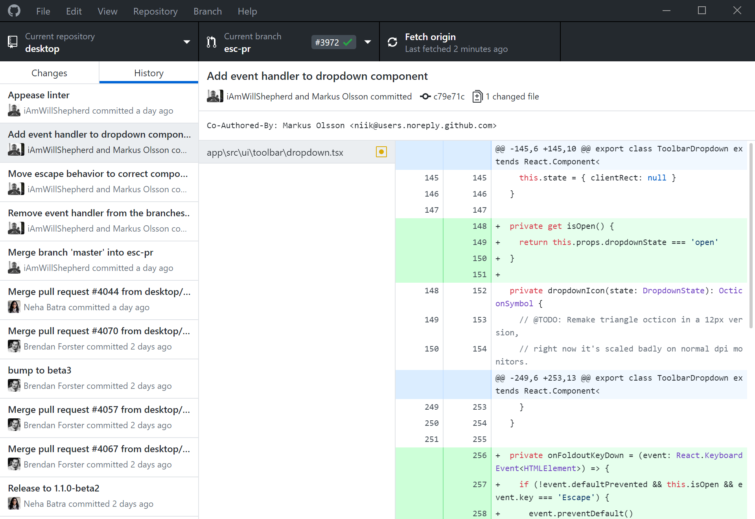


Git GUIs
Nearly every modern IDE will have a Git plugin (so does vim)
GitHub Desktop is a Git client that is oriented around GitHub. It works with non-GitHub repos too.
The JetBrains IDEs (IntelliJ, PyCharm, CLion) have pretty good Git integration.
Visual Studio has a pretty solid Git integration.

Slide 52

Further Topics
GitHub Issues
Markdown & making a good readme
Continuous Integration & Continuous Deployment
Releases / tags
Licensing
In-Depth Merging
Rebasing/merge conflicts
Git Stash
Gitignore
Gitattributes
Github-specific stuff
… and a lot more.
If you have questions right now, we can try to give a brief explanation.
We encourage you to learn these on your own! Practice! Try using Git for your programming assignments.

Slide 53

Great Resources for Further Reading
The official Git documentation: https://git-scm.com/doc
GitHub documentation: https://guides.github.com/
Atlassian Git tutorials: https://www.atlassian.com/git/tutorials
And of course: Google, Stack Overflow, and your peers!

Slide 54
Lessons Learned
Why git is important
How to configure git CLI
How to make a commit
How to push local repository to remote (GitHub)
How to manage files with git
How to contribute to open source projects
Identified more advanced topics for further consideration
Git is fun!

Slide 55
Questions?
Comments?
Concerns?
Anything from the previous
slides or b e y o n d?

